Slide 1

Topic 6
Understanding stress, depression and anxiety
The Wellbeing Toolkit
Dr Tina Rae

Slide 2

Aims of session
To clarify the nature of depression and anxiety
To highlight some key tools and effective thinking strategies from Cognitive behaviour therapy (CBT) and Positive psychology approaches which are useful in supporting CYP
To introduce some of the resources which support the development of these skills
To ensure that practitioners have the opportunity to develop and practice their own skills and access resources which are practical and user friendly

Slide 3

Using the word ‘stressed’

Slide 4

The loss of sadness?
For the last 2,500 years human beings could distinguish between normal sadness or suffering and clinical depression.
Since the development of the classification system for mental illness the boundary has become blurred
The only context the manual takes into account for depression is bereavement

Slide 5
What is stress?
“Stress is a demand made upon the
adaptive capacities of the mind and body”.
Fontana, 1989, p.3
Demands
Capacities
Notes:
Defining stress is quite a difficult and complex process given that it means different things to different people (in a similar vein as happiness, failure or success). Even though stress is a normal part of everyday life, too much stress makes young people become anxious, exhausted, tired and unable to function appropriately both inside and outside school.

Slide 6
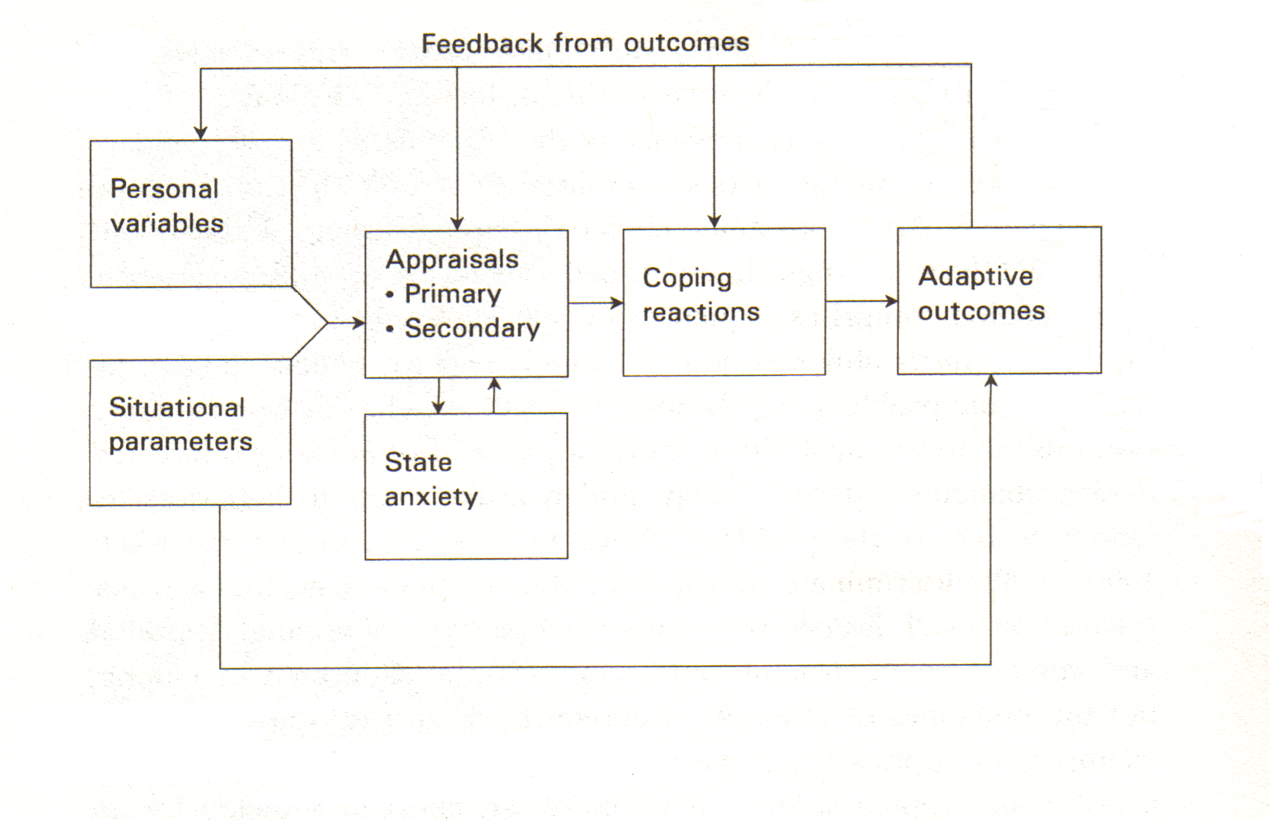
A transactional model of stress
From Matthews, Zeidner and Roberts, 2002

Slide 7
Reaction to Stressors General Adaption Syndrome Model
Normal resistance level
Biological | Alarm reaction | Stage of Resistance | Stage of Exhaustion
Psychological (Fontana) | Appraisal | Coping (Enhanced functioning) | Collapse (Impaired functioning)

Slide 8
Effects of Too Much Stress I
Cognitive Effects
Concentration and attention span decrease
Distractibility increases
Short- and long-term memory deteriorate
Response speed becomes unpredictable
Error rate increases
Organisation and planning deteriorate
Delusions and thought disorders increase
Emotional Effects
Ability to switch off worry and anxiety reduces
Feelings of health and well-being reduce
Over-sensitivity, defensiveness and hostility more likely
Emotional outbursts can increase
Depression and helplessness more likely
Self-esteem falls

Slide 9
Effects of Too Much Stress II
Behavioural Effects
Speech problems increase
Interests and enthusiasms diminish
Absenteeism increases
Drug abuse increases
Low energy levels
Disrupted sleep patterns
Increased cynicism about clients and colleagues
New information is ignored
Responsibilities are shifted on to others
Problems are solved at an increasingly superficial level
Bizarre behaviour patterns appear
Suicide threats may be made

Slide 10
Managing Stress
Reducing demands
Increasing capacities

Slide 11
Sources of Stress (Fontans, 1989)
Work
Unclear role
Powerlessness
Time pressures
Isolation from Colleagues support
Inadequate leadership
Role conflict
Overwork
Lack of variety
Poor communication
Interpersonal conflicts

Slide 12
Sources of Stress cont.
Home
Partner
Children
Domestic arrangements
Environmental pressures
Personal
Unrealistically high expectations and perfection issues
Negative cognitive appraisals / self talk
Need to please / be liked
Temperament
Low assertiveness

Slide 13
Sources of Stress
 | Familiar | New
WORK
HOME
YOU

Slide 14
Increasing capacities (See Wright & Frederickson, 1992)
Healthy lifestyle
Relaxation
Assertiveness
Effective thinking
Time management
Enhancing study skills

Slide 15
What is depression?
We often use the expression ‘I feel depressed’ when we’re feeling sad or miserable about life. Usually, these feelings pass in due course. But, if the feelings are interfering with your life and don't go away after a couple of weeks, or if they come back, over and over again, for a few days at a time, it could be a sign that you're depressed in the medical sense of the term.
Notes:
Depression is when a child’s mood is very low, with no obvious cause. Between the ages of eight and puberty, around 2 to 4% of children are diagnosed with depression, after puberty it is around 4 to 8%, and it is more common in girls than boys. The symptoms of depression are very similar to those in adults:

Slide 16
And
In its mildest form, depression can mean just being in low spirits. It doesn’t stop you leading your normal life, but makes everything harder to do and seem less worthwhile. At its most severe, major depression (clinical depression) can be life-threatening, because it can make you feel suicidal or simply give up the will to live.

Slide 17
Different types
Seasonal affective disorder (SAD) – this is seasonal depression which is related to day length. It usually comes on in the autumn and winter, when days are short and the sun is low in the sky, and gets better as the days get longer and brighter.
Postnatal depression – many mothers have ‘the baby blues’ soon after the birth of their baby, but it usually passes after a day or two. Postnatal depression is a much more serious problem and can occur any time between two weeks and two years after the birth.
Bipolar disorder (manic depression) – some people have major mood swings, when periods of depression alternate with periods of mania. When manic, they are in a state of high excitement, and may plan and may try to carry out over-ambitious schemes and ideas. They often then have periods of severe depression.

Slide 18
The numbers
At any one time, the estimated number of children and young people suffering from depression:
1 in 100 children
1 in 33 young people
Prevalence figures exceed treatment numbers:
about 25% of children and young people with depression detected and treated
Suicide is the:
3rd leading cause of death in 15–24-year-olds
6th leading cause of death in 5–14-year-olds

Slide 19
Symptoms
Key symptoms
persistent sadness, or low or irritable mood
loss of interests and/or pleasure
fatigue or low energy
Associated symptoms
poor or increased sleep
low self-confidence
poor concentration or indecisiveness
poor or increased appetite
suicidal thoughts or acts
guilt or self-blame
agitation or slowing of movement

Slide 20
Our job
Professionals in primary care, schools and community need to:
be aware of risk factors
engage in ‘active listening’ and ‘conversational techniques’
detect symptoms
provide appropriate support
know when to refer

Slide 21
A holistic approach
Care should be comprehensive and holistic and take into account:
drug and alcohol misuse
experience of bullying or abuse
parental depression
risks of self-harm and suicide
use of self-help materials and methods
issues of confidentiality

Slide 22
Mild depression
Treatment includes:
up to 4 weeks ‘watchful waiting’
non-directive supportive therapy
group CBT
guided self-help
no use of antidepressants at this stage

Slide 23
Moderate to severe depression NICE guidance
General recommendations
Approach tailored to needs of family
Family’s preferences to be taken into account
E.g. when too depressed
Does not want family involved
May require change of approach especially if symptoms deteriorate
Treatment starts with review by multidisciplinary team
First line of treatment is specific psychological therapy for about 3 months
Individual cognitive behavioural therapy
Interpersonal therapy
Shorter-term family therapy

Slide 24
Facts about anxiety
Anxiety disorders are among the most common mental, emotional, and behavioural problems to occur
About 13 of every 100 children and adolescents ages 9 to 17 experience some kind of anxiety disorder
Girls are affected more than boys. About 50% of children and adolescents with anxiety disorders have other mental/behavioral disorder
Anxiety disorders may coexist with physical health conditions as well
Notes:
Read over facts about anxiety.

Slide 25
Brief definition
Anxiety is a general feeling of apprehension or worry and is a normal reaction to stressful situations
Red flags should go up when the feelings become excessive, thoughts become irrational and everyday functioning is debilitated
Anxiety disorders are characterized by excessive feelings of panic, fear, or irrational discomfort in everyday situations

Slide 26
Production of fear and anxiety
Using brain imaging and neurochemical techniques several parts of the brain have been identified as key in the production of fear and anxiety
Two main components involved are the amygdala and the hippocampus
Amygdala - Emotional memories are stored here and alerts brain that a threat is present
Hippocampus - Encodes specific threatening events into memories

Slide 27
How anxiety is manifested
Students may feel a sense of dread
Have fears of impending doom
Experience a sense of suffocation
Anticipation of unarticulated catastrophe
Loss of control over their breath, swallowing, speech, and coordination
Somatic Complaints
Notes:
Read through symptoms of anxiety and answer any questions. People who present with somatic complaints are presenting symptoms that are caused by mental processes rather than immediate physiological causes (e.g., someone may “fake” being sick to get out of an anxiety-provoking situation).

Slide 28
Types of anxiety disorders
Generalized Anxiety Disorder (GAD)
GAD results in students experiencing six months or more of persistent, irrational and extreme worry, causing insomnia, headaches, and irritability.
Post-Traumatic Stress Disorder (PTSD)
PTSD can follow an exposure to a traumatic event such as natural disasters, sexual or physical assaults, or the death of a loved one. Three main symptoms: reliving of the traumatic event, avoidance behaviours and emotional numbing, and physiological arousal such as difficulty sleeping, irritability or poor concentration.
Notes:
Read through different types of anxiety disorders. You may want to begin by saying that you will be defining the following disorders: Generalized Anxiety Disorder, Post-Traumatic Stress Disorder, Panic Disorders, Specific Phobias, Social Phobia, Separation Anxiety Disorder, and Obsessive Compulsive Disorder.

Slide 29
Panic Disorders
Characterized by unpredictable panic attacks, which are episodes of intense fear, physiological arousal, and escape behaviours. Common symptoms: heart palpitations, shortness of breath, dizziness and anxiety and these symptoms are often confused with those of a heart attack.
Specific Phobias
Intense fear reaction to a specific object or situation (such as spiders, dogs, or heights) which often leads to avoidance behaviour. The level of fear is usually inappropriate to the situation and is recognized by the sufferer as being irrational

Slide 30
Disorders continued
Social Phobia
Extreme anxiety about being judged by others or behaving in a way that might cause embarrassment or ridicule and may lead to avoidance behaviour.
Separation Anxiety Disorder
Intense anxiety associated with being away from caregivers, results in youths clinging to parents or refusing to do daily activities such as going to school.
Obsessive-Compulsive Disorder (OCD)
Students may be plagued by persistent, recurring thoughts (obsessions) and engage in compulsive ritualistic behaviours in order to reduce the anxiety associated with these obsessions (e.g. constant hand washing).

Slide 31
Comorbidity
Comorbid diagnoses of depressive disorders, ADHD, and other anxiety disorders are common in anxiety patients.
Symptoms that may appear to be ADHD:
Restlessness, feeling keyed up or on edge
Difficulty concentrating, mind going blank
Irritability
Clinically significant distress or impairment in social or academic areas
Notes:
Comorbidity - the presence of one or more disorders (or diseases) in addition to a primary disease or disorder.
Sometimes anxiety masks itself in symptoms that would lead you to a different diagnosis. Read through ADHD example…explain that although these symptoms lead you to think that the client presents with ADHD, the client may instead present with an anxiety disorder or may be displaying both. The key is to determine which disorder is the primary disorder.

Slide 32
Effective ways to treat anxiety
Cognitive-behavioural treatment( young people learn to deal with fears by modifying the ways they think and behave)
Relaxation techniques
Biofeedback (to control stress and muscle tension)
Family therapy
Parent training
Medication
Notes:
Biofeedback is a treatment technique in which people are trained to improve their health by using signals from their own bodies. It is used to help tense and anxious clients learn to relax.

Slide 33
Strategies for dealing with anxious Students
Because transitions and separation are frequently difficult for children with anxiety disorders, accommodate student’s late arrival and provide extra time for changing activities and locations.
Recognize that often it is a child’s anxiety that causes him or her to disregard directions, rather than an intentional desire to be oppositional.
Develop a “safe” place where the child can go to relieve anxiety during stressful times or provide calming activities.
Encourage the development of relaxation techniques that can work in the school setting. Often these can be adapted from those that are effective at home.
Notes:
You may want to explain a little about relaxation in the classroom…teach students to breathe in slowly through the nose, and out through the mouth as if they were filling up a balloon with air and then letting it out. Children should breathe in to the count of 5, and out to the count of 5 which means “Breathe in, two, three, four, five, and out, two, three, four, five” (at a rate of about one count per second); Adolescents should breathe in and out to the count of 8 and have them take 3 normal breaths in between deep breaths.

Slide 34
Work with a child regarding class participation and answering questions on the board, understanding that many anxious CYP fear answering incorrectly.
Encourage small group interactions and provide assistance in increasing competency and developing peer relationships.
Reward the student’s efforts.
Provide an organized, calming, nurturing and supportive environment.
For maximum effectiveness, foster feedback from CYP about these interventions

Slide 35
Need to develop school based preventative strategies
Healthy lifestyle
Relaxation
Assertiveness
Effective thinking – CBT
Time management
Enhancing study skills

Slide 36
Effective thinking
Identifying and challenging irrational beliefs is an important first step. Such beliefs are exaggerated, oversimplified, illogical, unrelated to evidence or too absolute.
When I make a mistake it is terrible, catastrophic, disastrous
If someone gets upset when I say something to them, then it is all my fault
If someone turns down my request, they are rejecting me
It is vital that everyone approves of me and what I do all the time (even if I am totally irritating and unreasonable)

Slide 37
Effective thinking
Irrational belief
I need to be thoroughly competent and achieving or I am not worthwhile
My past is the cause of my present problems
Rational equivalent
While I gain great pride from competence and achievement, I need to accept that I, like everyone else, have human limitations and fallibilities
Just because past events have strongly influenced me, I do not have to be attached to them for ever, I can learn from them

Slide 38
Ineffective self talk
Worrying about a future situation
Catastrophising
Setting unrealistic standards
Over-reacting to feelings of anxiety
Being overly worried about what others think
Putting yourself down
Focusing on set-backs and not owning successes
Not setting clear, manageable goals or focusing on tasks that will achieve them.

Slide 39
Constructive Self Talk
Calming Self-Talk
Tell yourself to stay calm – ‘relax, calm down, take a deep breath, count to 10, breath slowly…’
Tell yourself you can cope – ‘I can handle this situation. I’ve got the skills to cope with this. I can solve this problem if I relax and think about it.’
Coaching Self-Talk
This might involve using a problem solving framework – ‘Right! First define an objective … now think of possible solutions … now choose one to implement’.
Or reminding yourself to use new skills in tricky situations – ‘Right! She’s getting angry. I must listen to what she is saying and acknowledge her feelings’.

Slide 40
MOST IMPORTANT TO TEACH THESE SKILLS TO THE MOST VULNERABLE STUDENTS

Slide 41
All learners will probably experience the associated stressors when revising/undertaking assessments:
Subjective - aggression, fatigue, low self-esteem
Behavioural - restlessness, emotional outbursts, taking drugs
Cognitive - inability to concentrate, mental blocks, hypersensitive
Physiological - sweating, dry mouth, increased heart rate
(Cox, 1981)

Slide 42
It’s all about control
“People who believe they can exercise control do not engage in apprehensive thinking, they are not bothered by threat or challenge”
(Frydenberg, 1997)

Slide 43
Need to promote:
Autonomy and control

Slide 44
Planning ahead strategy helps to achieve a sense of control
Imagine - situation in detail
Prepare - seek support
Be aware of all possibilities and tell MIND to stay calm in each one
Make contingency plans - e.g. make notes for your presentation!
Relax - genuine relaxation before the event
Unwind - reward yourself

Slide 45
Implementing change –
behavioural experiments
Stages
1. Identify the unhelpful belief
2. identify the more helpful alternative
3. Test which belief is more accurate
4. Discuss the results of the test
Outcome
Evidence to challenge the core beliefs and NATs

Slide 46
More strategies to implement change
Re-Framing
Re-frame NATs into more balanced, positive, realistic thoughts.
Distraction
Describing what you see.
Get absorbed
Self-talk
Bin them
Top talk

Slide 47
And more
Positive Automatic Thoughts
Weekly Positive Diary, for example: ‘Someone said hello.’ ‘My teacher praised me.’
Goal Setting
Set realistic goals
Practise strategies

Slide 48
Prevention is better than cure
Logical conclusion
provide copious opportunities to learn and practice a range of effective self management skills
increase ability to cope with stress and anxiety
maintain locus of control and well-being

Slide 49
Teach all students methods of coping with stress and anxiety
Diet
Relaxation
Meditation
Time management
Physical exercise
Additional training
Counselling
Reframing
Improving social support networks
Peer support groups
Improved resource allocation
Self-analysis

Slide 50

Thank you for listening and participating

